Slide 1
When Change of Requirements Occurs
CS 4473: Requirement Analysis
Group 2:
Sihui He,
Chun Yang,
Yifei Zhang,
Yulun Feng,
Yuhan Zhang

Slide 2
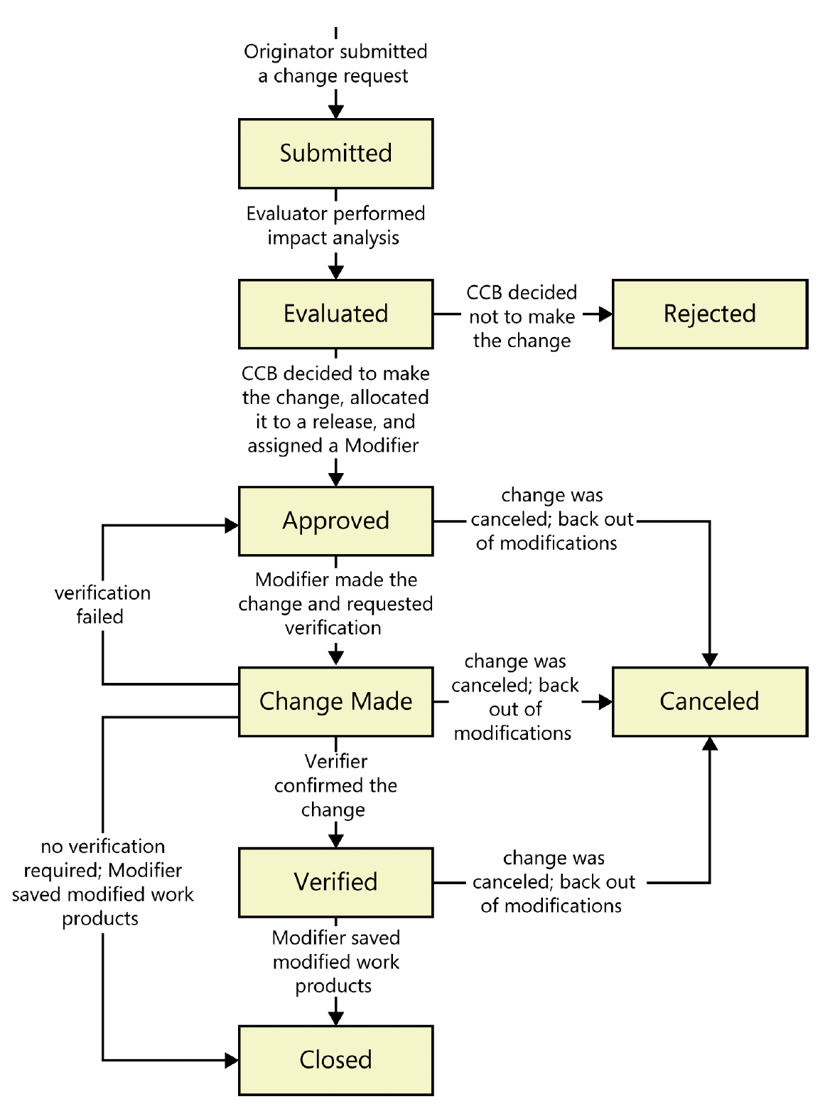
Stages for changing requirements
A meticulously crafted procedure

Slide 3
Logical Partitioning of The Work
Partition No. | Content partition description | Name of the Responsible Member
1 | Introduction and Submitted process (p 4 - 8) | Yuhan Zhang
2 | Evaluation Process and Rejection Criteria (p 10 - 17) | Yifei Zhang
3 | Approval Process and Cancellation Stage (p 18 - 27) | Sihui He
4 | Implementing Changes and Cancellation Review (p 28 - 33 ) | Yulun Feng
5 | Verification and Agile practice (p34 - 44 ) | Chun Yang

Slide 4
Submitted Process: Changing Requirements
Requirement change management plays an important role in the business world. Change management in the business scenario is a hard-hitting assignment because of continuously changing customer choices in respect of requirements. Giving no attention to requirement change management result in consumers’ discontent.
It also affects market value. Dealing in requirement change, it’s far important to cope with those challenges to undertake the requirement of the business consumers. [J. Ahmad et al.,2022]
Notes:
Automata丶

Slide 5
Changing Requirements: Who? Why? What result?
Changing requirements are a common case in the project lifecycle that can become a real problem to a project’s success. They mostly come from customers and stakeholders.
As for clients, they sometimes don’t know what exactly they want at the very beginning and may come up with better ideas afterwards. Also, they often don’t understand what consequences for the whole project their changes may have, and what it takes for the project team to implement them. The same can be said about stakeholders, as they sometimes don’t know what stands behind the project implementation. [Saleforce, 2021]
Notes:
Automata丶

Slide 6
Changing Requirements: Who? Why? What result?
Making some changes is inevitable as customer needs may change over time, and the delivered project is expected to meet their needs. So, project managers should be aware of what these changes lead to and be ready to manage them.
Notes:
Automata丶

Slide 7
Changing Requirements: Who? Why? What result?
The bad thing about changing requirements is real, they can become uncontrolled and lead to project failure in the end.
If the project team is expected to deliver more tasks with the same resources and in the same time, the following consequences become possible:
delays and even failure to meet important deadlines;
exceeding the budget;
misunderstandings among the team members and with clients/stakeholders;
lack of control over the project;
decreased quality of the final outcome;
disappointed customers. [Epicflow, Victoria Sokolova, 2022]
Notes:
Automata丶

Slide 8
What to do when submitting?
Setting and documenting current requirements
Clarifying the consequences of the changes
Specifying change control procedure
Creating a project schedule
Communicating with the team
Notes:
Automata丶

Slide 9
Stages for changing requirements
A meticulously crafted procedure

Slide 10
Evaluation Process
The main idea of change analysis is to identify how the requested change impacts the existing design or system. To this effect, methods of change impact analysis found in literature can be grouped based on objects that are impacted: starting impact set, estimated impact set and actual impact set. [Jayatilleke and Lai 2017]
Notes:
Automata丶

Slide 11
Evaluation Process
Criteria for evaluating a requirement change: [Emam, et al., 1997] proposed a method to develop a causal model in which the criteria for evaluating the change process is whether the process achieves its objective. Three causal relationships were identified, and three general techniques were used in the analysis(deviation analysis, comparative analysis, and anchoring). The evaluation outcome does not require waiting for data on system failures
An example of non-process causes of implementation problems:
People-related Problems: lack of expertise of participants in the process, lack of knowledge about the requirements documents by the domain experts who are consulted, turnover of competent staff, and ability to identify and schedule competent staff to review the requirements documents. [Emam, et al., 1997]
Notes:
Automata丶

Slide 12
Evaluation Process
Structure of the evaluation team: It is important to realize that based on the level of the organizational structure, decision-making concepts differ and this can be detrimental to the success of a project when dealing with requirement changes. An organization can be divided into two parts i.e. the business organization and the IT organization. Each of these two parts can then be divided into three levels of structure: Executive, Tactical and Operational. The differing levels of decision making between these structural levels have been identified to be a challenging factor in requirement changes management. [Jayatilleke and Lai 2017]
Notes:
Automata丶

Slide 13
Evaluation Process - Steps involved in the evaluation:
There are a lot of agile methods available for requirements change management. One of the most important aspects of agile methods is that change is a built-in aspect of the process [Eberlein and Leite 2002]. 10 agile processes that deal with RCM were extracted by [Jayatilleke and Lai 2017] as follows:
Face-to-face communication [Cao and Ramesh 2008]
Customer involvement and interaction [Eberlein and Leite 2002]
Iterative requirements [Cao and Ramesh 2008]
Requirement prioritisation [Inayat, et al., 2015]
Prototyping [Cao and Ramesh 2008]
Notes:
Automata丶

Slide 14
Evaluation Process - Steps involved in the evaluation:
6. Requirements modelling [Ernst, et al., 2014]
7. Review meetings and acceptance tests [Ramesh, et al., 2010]
8. Code refactoring [Berry, 2002]
9. Retrospective [Ramesh, et al., 2010]
10. Continuous planning [Jun, et al., 2010]
The iterative and dynamic nature of agile development method promotes constant feedback and communication between the stakeholders. Therefore, the management of changes is continuous during the iterations.
Notes:
Automata丶

Slide 15
Rejection Criteria
1
Common reasons for requirement change rejection: Software cost/effort estimation is referred to as the process of predicting the effort required to develop a software system [Leung and Fan 2002][Rajper and Shaikh 2016]
The base condition of a change request for being approved or disapproved is that whether the change is doable or not doable[Bhatti, etal., 2010], which is decided in the evaluation phase of RCM process.
Notes:
Automata丶

Slide 16
Rejection Criteria
Communication process for rejected changes: In approval or disapproval step of the process, the formal decision is issued by CCB. If the change request is disapproved then the reasons of the disapproval are forwarded to the initiator of the change request. The major stakeholders of this step are “CCB”, “quality assurance team”, “relevant team members” of the project and “initiator of the change requests". In case of disapproval the “reasons of disapproval” of the change requests are the typical work products of this step. [Bhatti, etal., 2010]
An example of change rejection from Mozilla provided by [Souza, 2015]:
When a developer resolves an issue, he attaches the source code patch to the corresponding issue report in Bugzilla and asks a specific colleague to review it (setting the review? flag). Had the change been rejected, Reviewer would alter the flag to review- and Developer would have to attach. a new patch to be reviewed.
Notes:
Automata丶

Slide 17
Rejection Criteria
1
Steps to reconsider or refine a rejected change: Change rejection triggers rework, which is the act of improving a change that was rejected or the act of evaluating the improved change after having evaluated the corresponding original change. [Souza, 2015]
For instance, when a change submitted to code review receives a negative review, there is rework for both the developer, who will work one more time on the change to resolve the issue, and for the reviewer, who will have to perform an additional code review. [Souza, 2015]
Notes:
Automata丶

Slide 18
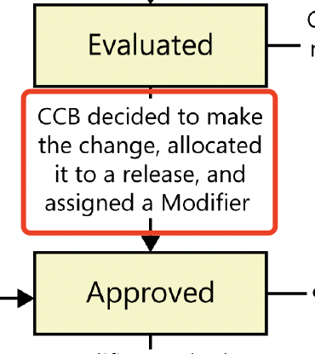
Approval Process - Potential Authorities Involved - P1
CCB
Responsible for reviewing, evaluating, approving requirement changes
Decides to make the change, allocate it to a release, and assign a modifier [Weigers and Beatty, 2013]
Modifier (Normally Development Team)
After approval process, he/she will make change and requested verification against new requirements [Weigers and Beatty, 2013]
Typical verification activities: requirement review, consistency check, traceability analysis, etc

Slide 19
Approval Process - Potential Authorities Involved - P2
Project Manager
Oversees the change management process, ensuring that the change request is documented, reviewed, and decided upon in a timely manner. [Shafiq et al., 2018]
Business Analysts
Responsible for detailing the change request and conducting an initial assessment. Business analysts may present the change to the CCB, highlighting the business needs, benefits, and potential impacts of the change. [Shafiq et al., 2018]

Slide 20
Approval Process - Potential Authorities Involved - P3
QAs
Evaluate the implications of the change on testing strategies, test plans, and overall quality assurance processes. They ensure that the change can be tested adequately and that it does not introduce quality risks
Legal and Compliance Department
For changes that may have legal, regulatory, or compliance implications, these officers assess the change to ensure that it complies with relevant laws, standards, and industry regulations.
Finance Department
Reviews the cost implications of the change, ensuring that it fits within the project budget or determining the need for additional funding. [Shafiq et al., 2018]

Slide 21
Approval Process - Criteria for Approval
Alignment with project goals and objectives
Stakeholder agreement
Feasibility reassessment regarding technical, financial, operational feasibility
Risk reevaluation
Impact analysis reassessment: understanding the effects regarding new requirements on project scopes, timeline, resources, etc.
Compliance and regulatory check
Documentation and traceability
”The changes need to be formally captured and in documented baselines of the requirements along with the configuration information“ [ISO/IEC/IEEE, 2018]

Slide 22
Approval Process - Communication of Approval
Goals: Ensure all the stakeholders are informed of the decision made regarding requirement changes.
Formal approval notification:
Initiated by CCB or PM after a change is approved.
Participants: all stakeholders, including clients, project teams, investors, etc.
Update requirement documentation by PM or BA
Update project plan and timeline by PM
Participants: Dev teams need to understand their new timelines and requirements
Regular update and progress reports from Dev Teams

Slide 23
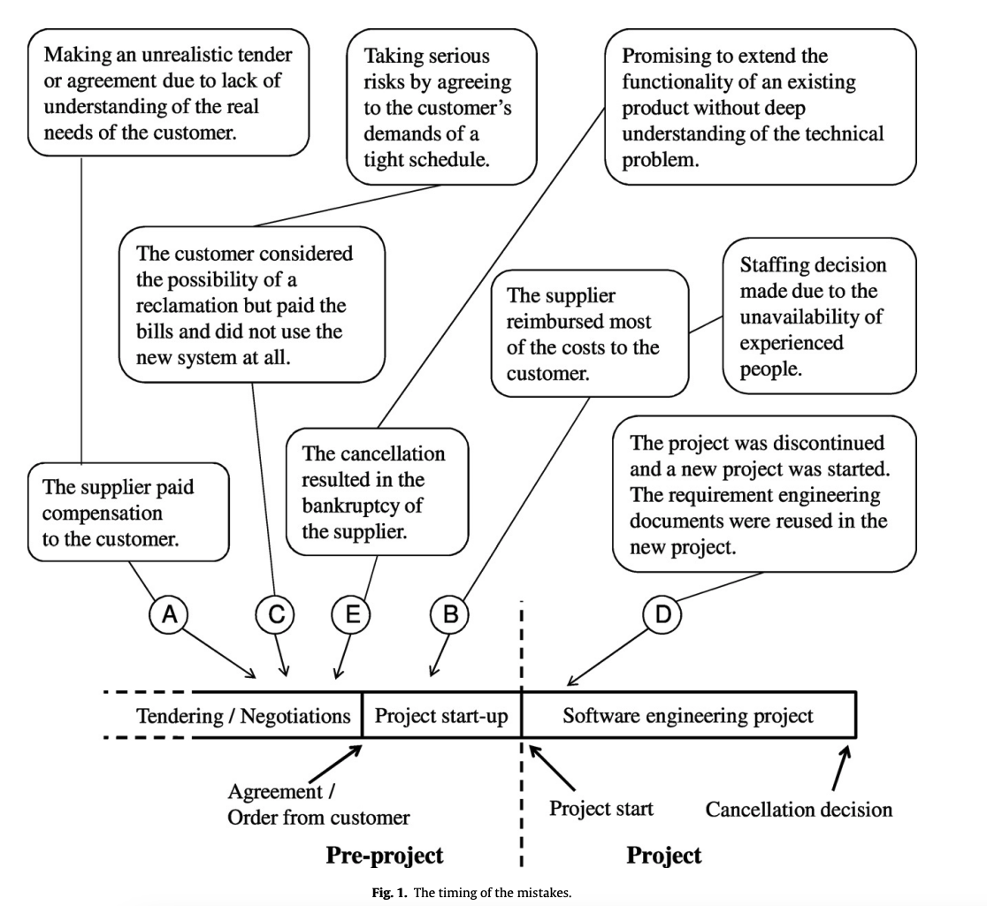
When does cancellation usually happen?
[Ahonen and Savolainen, 2010]Fig.1

Slide 24
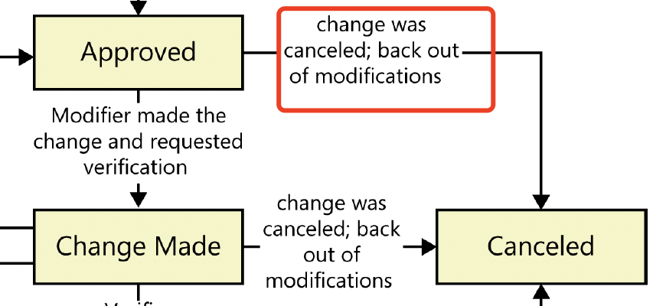
Cancellation Stage - Common Reasons to Cancel p1
1. Inadequate Resource Availability: Changes in the availability of key resources, including personnel, technologies, or materials, may lead to the cancellation of a requirement change due to the inability to support its implementation effectively. [Ahonen and Savolainen, 2010]
2. Cost Prohibitive: The estimated cost of implementing the change might exceed the projected benefits, making it economically not feasible. [Ahonen and Savolainen, 2010]
3. Adverse Impact on Project Schedule: If the requirement change is expected to cause significant delays that could jeopardize project deadlines or critical milestones, it may be deemed necessary to cancel the change to preserve the project timeline. [Shafiq et al., 2018]

Slide 25
Cancellation Stage - Common Reasons to Cancel p2
4. Stakeholder Disagreement: Lack of consensus among key stakeholders or the client regarding the necessity, scope, or specifications of the change can lead to its cancellation.
5. Change in Business or Market Conditions: External factors such as market shifts, regulatory changes, or alterations in business strategy.
6. Risk Escalation: Initial risk assessments may not always capture the full extent of the risks associated with a change. If subsequent analyses reveal higher-than-acceptable risks, the change might be canceled to protect the project and the organization.
7. Feasibility Concerns: Upon further analysis, the change may prove to be technically infeasible due to limitations in current technology, resources, or expertise available within the project team or timeframe.

Slide 26
Cancellation Stage - Communication for Canceling a Change
Goal: To inform all the stakeholders about the cancellation of decisions and ensure traceability of the decision.
Formal Notification: Send a formal communication to all impacted stakeholders about cancellation decision.
Team Meetings: Hold meetings with the project team and any directly impacted groups to discuss the cancellation’s impact on the project plan, timelines, and responsibilities. Use this time to address concerns and answer questions.
This is the common way at my company too. We usually holds several all hands meeting to address the concerns. Team meetings are the way for senior leadership to understand employees’ concerns.

Slide 27
Cancellation Stage - Communication for Canceling a Change
Stakeholder Engagement: For stakeholders significantly impacted by the cancellation, individual or small group meetings might be necessary to discuss the implications and gather feedback.
Update Documentation: Ensure all project documentation reflects the cancellation of the change. This includes requirements documents, project plans, and risk assessments.
Feedback meeting: To capture lessons learned from the cancellation process.

Slide 28
Implementing Changes: Before Changes Made
Implement the Approved Requirement Changes:
- Identification and Documentation: When implementing a change, it's crucial to remember documenting all aspects of the change, like the scope, the reasons of the change, and the expected impact from the change. This comprehensive documentation ensures that everyone involved understands the change's purpose and scope, facilitating smoother implementation and integration into the existing framework. [Boehm, 1991]
- Impact Analysis: To understand how the change will influence various project facets, like schedules, resources, and other interconnected requirements, it is essential to conduct impact analysis. This analysis helps in anticipating potential challenges and preparing strategies to address them, ensuring the project stays on track. [Lehtola et al., 2004]
Notes:
Allen

Slide 29
Implementing Changes: Before Changes Made
Implement the Approved Requirement Changes:
- Update Requirement Specifications: Once a change is approved, it's necessary to update the requirement specifications to accurately reflect the new changes. This step is vital to maintain clarity and avoid ambiguity, ensuring that the project team has a clear understanding of the revised requirements and their roles in implementing these changes. [Weigers and Beatty, 2013]
Notes:
Allen

Slide 30
Implementing Changes: Communicating and Monitoring
Coordination Among Teams and Integration into the Current Project Plan:
Cross-Team Coordination: Ensure that all teams are aligned with the change. This may involve meetings, updates to project plans, and adjustments to team responsibilities. One way is to establish a reference model for requirements traceability. [Ramesh and Jarke, 2001]
Integration with Current Plans: Adjust the project plan, schedules, and resource allocations to accommodate the change. Ensure that the integration is seamless and does not disrupt ongoing work. [Weigers and Beatty, 2013]
Notes:
Allen

Slide 31
Implementing Changes: Communicating and Monitoring
Monitoring and Controlling Changes During Implementation:
Track Implementation: Regularly monitor the progress of the change implementation to ensure it is aligned with the project plan.
Quality Assurance: Conduct testing and reviews to ensure that the change meets the required standards and does not introduce new issues.
Adjustments and Iterations: Be prepared to make further adjustments as the change is implemented, responding to any unforeseen issues or feedback.
Notes:
Allen

Slide 32
Change Cancellation: what do do then?
Reviewing the Reasons and Impacts of Canceling Changes:
Assessment of Cancellation Reasons: Discuss why a change is being considered for cancellation—whether due to feasibility, cost, or a shift in project priorities.
Impact Analysis: Evaluate the consequences of canceling the change, including how it will affect the project's scope, timeline, and stakeholder expectations, and create an impact analysis template. [Weigers and Beatty, 2013]
Notes:
Allen

Slide 33
Change Cancellation: what do do then?
Documentation and Record-Keeping for Future Reference:
Comprehensive Documentation: Ensure that all decisions, along with their rationales and impacts, are thoroughly documented. This includes documenting the reasons for canceling a change and the lessons learned from the process. [Gotel and Finkelstein, 1994]
Knowledge Sharing: Discuss how this documentation will be stored and shared within the organization to inform future projects and decisions. [Dingsøyr and Conradi, 2002]
Notes:
Allen

Slide 34
Change Cancellation: what do do then?
Documentation and Record-Keeping for Future Reference:
Audit Trail: Emphasize the importance of maintaining a clear audit trail for accountability and for reviewing the project's history. [Anton and Potts, 1998]
Notes:
Allen

Slide 35
Verification: Are we building the product right?
Verification is the process of checking whether the software changes meet the specified requirements and design specifications [LinkedIn, n.d.]
In the development of a mobile banking app, verification involves reviewing the app's design, code, and functionalities to ensure they align with industry standards. This might involve code reviews, unit tests, and verifying features like money transfer.
Requirements changes typically are verified through peer reviews to ensure that modified deliverables correctly address all aspects of the change. [Weigers and Beatty, 2013]

Slide 36
Verification: Are we building the product right?
Multiple team members might verify the changes made through testing or review
Tester
Project Manager
BA
Developers

Slide 37
Best practice
Software testers should plan and prioritize testing activities based on the risk and impact of the software changes, utilizing risk-based testing or impact analysis techniques. [LinkedIn, n.d.]
They should communicate and collaborate with developers, users, and stakeholders throughout the testing process, using agile or iterative methods or tools.
Document and report the testing results, issues, and feedback with test management or defect tracking systems.

Slide 38
Testing Techniques
Unit Test
ensure that code changes do not introduce defects or disrupt the stability of a software system
Regression Testing
retesting the existing functionalities to ensure that they still work as expected after code changes
Acceptance Testing
make sure the changes made are meeting acceptance criterias

Slide 39
Shit happens sometimes…
Change in Business Priorities [McConnell, S. , 1996]
A shift in business priorities or strategic direction, certain requirements may no longer be relevant or necessary
Technical Feasibility [Sommerville, I. ,2016]
Technically challenging or not feasible to achieve within the project constraints
Regulatory Compliance [Sommerville, I. ,2016]
Cancellation of certain requirement changes to ensure compliance and mitigate legal risks

Slide 40
Close the ticket
Change Status: Closed or Canceled
Update documents and tickets
Notify stakeholders about the details

Slide 41
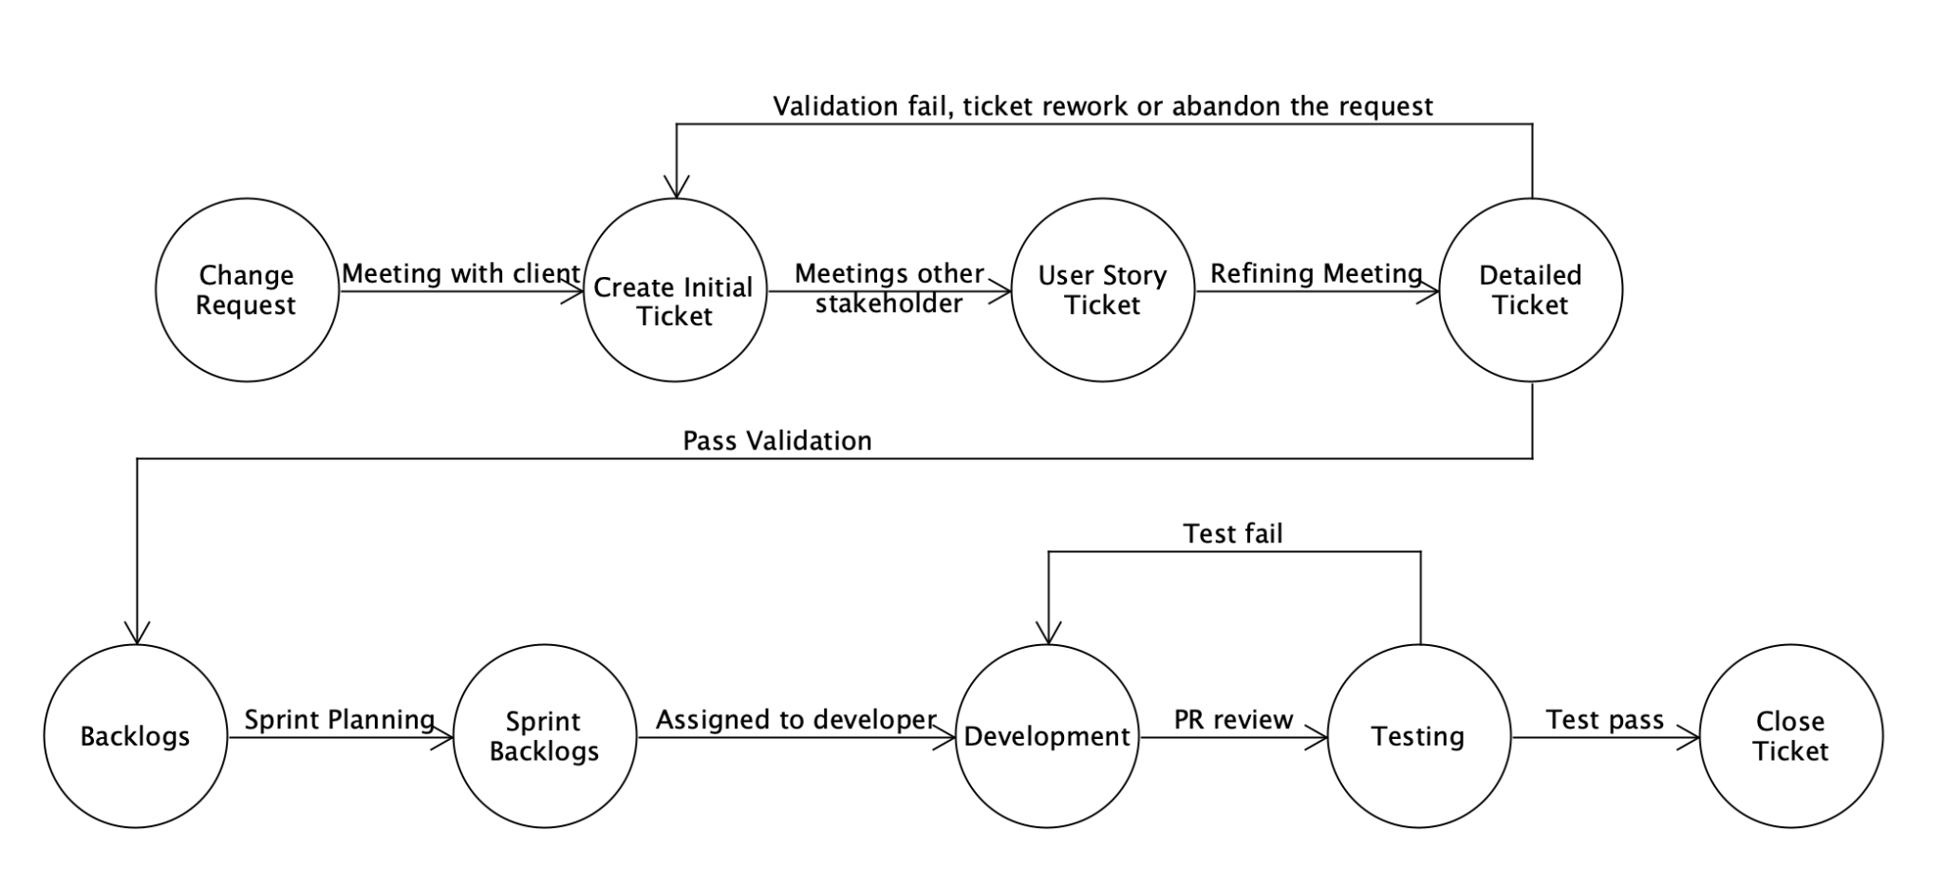
An example of Agile industrial adoption
Meeting with client
Include at least one dev
Use video recording for customer elicitation session
Refining Meeting
Create a template that includes all important attributes such as priority, acceptance criterias, story point, etc
Refined ticket lists detailed test cases

Slide 42
An example of Agile industrial adoption
Roadmap
Aside from this workflow in the diagram, BA or project manager have a feature release roadmap for sprint planning

Slide 43
Use tools to make life easier
Manage change request
Use template for ticket
Use JIRA and wiki tools to document changes and decisions
Use video recording for customer elicitation session
Practice for good code base quality
Create Unit Tests for every new functions
Refined ticket listed details test case

Slide 44
Use tools to make verification easier
Regression Test Automation
Manual Test VS Automation Test
Use tools such as Cypress for integration test
Saves time for both tester while ensures the quality of code base

Slide 45
Reference (1/3)
Ahmad, J., et al. (2022). Quality Requirement Change Management’s Challenges: An Exploratory Study Using SLR. IEEE Access, 10, 127575–127588. https://doi.org/10.1109/ACCESS.2022.32127575
Ahonen, J., & Savolainen, P. (2010). Software engineering projects may fail before they are started: Post-mortem analysis of five cancelled projects. Journal of Systems and Software, 83, 2175-2187. https://doi.org/10.1016/j.jss.2010.06.023
Anton, A. I., & Potts, C. (1998). The use of goals to surface requirements for evolving systems. In Proc. 20th International Conference on Software Engineering (pp. 157-166).
Berry, D. M. (2002). The inevitable pain of software development, including of extreme programming, caused by requirements volatility. In Proc. Eberlein and Leite.
Bhatti, M. W., Hayat, F., Ehsan, N., et al. (2010). A methodology to manage the changing requirements of a software project. In Proc. 2010 Int. Conf. Computer Information Systems and Industrial Management Applications (CISIM) (pp. 319-322). IEEE.
Bohem, B. W. (1991). Software risk management: Principles and practices. IEEE Software, 8(1), 32-41.
Cao, L., & Ramesh, B. (2008). Agile requirements engineering practices: An empirical study. IEEE Software, 25(1).
Dingsøyr, T., & Conradi, R. (2002). A survey of case studies of the use of knowledge management in software engineering. International Journal of Software Engineering and Knowledge Engineering, 12(4), 391-414.
Eberlein, A., & Leite, J. (2002). Agile requirements definition: A view from requirements engineering. In Proc. Int. Workshop Time-Constrained Requirements Engineering (TCRE’02) (pp. 4–8).
El Emam, K., Holtje, D., & Madhavji, N. H. (1997). Causal analysis of the requirements change process for a large system. In Proc. Int. Conf. Software Maintenance (pp. 214–221).
Notes:
Reference Automata

Slide 46
Reference (2/3)
Epicflow. (2024). Changing requirements in project management. https://www.epicflow.com/blog/changing-requirements-in-project-management-how-to-stay-on-track/
Ernst, N. A., Borgida, A., Jureta, I. J., & Mylopoulos, J. (2014). Agile requirements engineering via paraconsistent reasoning. Information Systems, 43, 100–116.
Gotel, O., & Finkelstein, A. (1994). An analysis of the requirements traceability problem. In Proc. First International Conference on Requirements Engineering
Inayat, I., Salim, S. S., Marczak, S., Daneva, M., & Shamshirband, S. (2015). A systematic literature review on agile requirements engineering practices and challenges. Computers in Human Behavior, 51, 915–929.
International Organization for Standardization. (2018). ISO/IEC/IEEE 29148:2018 - Systems and software engineering — Life cycle processes — Requirements engineering.
Jayatilleke, S., & Lai, R. (2017). A systematic review of requirements change management. Information and Software Technology. https://doi.org/10.1016/j.infsof.2017.09.004
Jun, L., Qiuzhen, W., & Lin, G. (2010). Application of agile requirement engineering in modest-sized information systems development. In Proc. Second World Congress on Software Engineering (WCSE), vol. 2 (pp. 207–210). IEEE.
Lehtola, L., Kauppinen, M., & Kujala, S. (2004). Requirements prioritization challenges in practice. In Proc. 5th Int. Conf. on Product Focused Software Process Improvement (pp. 497-508).
Leung, H., & Fan, Z. (2002). Software cost estimation. In Handbook of Software Engineering (pp. 1–14). Hong Kong Polytechnic University.
LinkedIn. (n.d.). How do you verify/validate software changes? Retrieved from https://www.linkedin.com/advice/0/how-do-you-verify-validate-software-changes-skills-software-testing
McConnell, S. (1996). Rapid Development: Taming Wild Software Schedules. Microsoft Press.
Notes:
Reference Automata

Slide 47
Reference (3/3)
Rajper, S., & Shaikh, Z. A. (2016). Software development cost estimation: A survey. Indian J. Sci. Technol., 9(31).
Ramesh, B., & Jarke, M. (2001). Toward reference models for requirements traceability. IEEE Transactions on Software Engineering, 27(1), 58-93.
Ramesh, B., Cao, L., & Baskerville, R. (2010). Agile requirements engineering practices and challenges: an empirical study. Information Systems Journal, 20(5), 449
Salesforce. (2024). What are customer expectations, and how have they changed? Retrieved from https://www.salesforce.com/resources/articles/customer-expectations/
Shafiq, M., Zhang, Q., Akbar, M. A., Khan, A., Hussain, S., Amin, F.-e, Khan, A., & Soofi, A. (2018). Effect of Project Management in Requirements Engineering and Requirements Change Management Processes for Global Software Development. IEEE Access, PP, 1-1. https://doi.org/10.1109/ACCESS.2018.2834473
Sommerville, I. (2016). Software Engineering (10th ed.). Pearson Education Limited.
Souza, R. R. G. (2015). Inappropriate Software Changes: Rejection and Rework. Journal.
Visure Solutions. (2024). Requirements Change Management: Definition, Process | Complete Guide. Retrieved March 13, 2024, from https://visuresolutions.com/requirements-change-management/
Weigers, K., & Beatty, J. (2013). Change happens. In Software Requirements (3rd ed., ch. 28, p. 477). Microsoft.
Weigers, K., & Beatty, J. (2013). Change impact analysis. In Software Requirements (3rd ed., ch. 28, p. 484). Microsoft.
Weigers, K., & Beatty, J. (2013). Documenting the requirements. In Software Requirements (3rd ed., ch. 10). Microsoft.
Weigers, K., & Beatty, J. (2013). Enhancement and replacement project. In Software Requirements (3rd ed., ch. 21, p. 398). Microsoft.
Weigers, K., & Beatty, J. (2013). Enhancement and replacement project. In Software Requirements (3rd ed., ch. 21, p. 401). Microsoft.
Notes:
Reference Automata

Slide 48
Q&A

Slide 49
Thank You!

